Slide 1
Environmental Impact Assessment

Slide 2
Dr Kabera Telesphore

Slide 3
If you have any suggestions about this course
Any other questions on study
Please do not hesitate to contact me!
Contact me: kaberacriss@gmail.com

Slide 4
SYLLABUS
Environmental Impact Assessment
ChapterⅠ Introduction
ChapterⅡ Process And Method
ChapterⅢ Overview of EIA Cases
ChapterⅣ Special topic of EIA

Slide 5
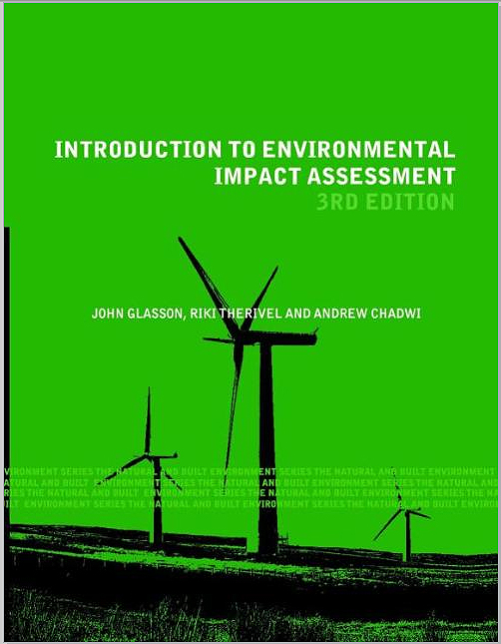
Recommended text books
Title: Introduction to Environmental Impact Assessment
Author: Glasson, John Therivel, Riki Chadwick, Andrew
Publication: London, New York Taylor & Francis Routledge, 2005.
Wood, C. (2002). Environmental Impact Assessment: a Comparative Review (2nd Edition). Harlow: Prentice Hall
Therivel, R. and Partidário, M.R. (1996). The Practice of Strategic Environmental Assessment. London: Earthscan
Some website:
http://www.netlibrary.com/
http://www.elsevier.com/locate/eiar
http://ec.europa.eu/environment/eia/home.htm
http://www.nepa.gov/nepa/nepanet.htm

Slide 6
US EPA
Risk Models and Tools
http://cfpub.epa.gov/ncea/cfm/nceariskmodels.cfm?ActType=DatabaseAndTools&detype=model&excCol=archive
EPA hazardous pollutant risk assessments
http://cfpub.epa.gov/ncea/cfm/bmds.cfm
The Office of Pollution Prevention and Toxics (OPPT) has developed several exposure assessment methods, databases, and predictive models to help in evaluating: what happens to chemicals when they are used and released to the environment; and how workers, the general public, consumers and the aquatic ecosystems may be exposed to chemicals.
http://www.epa.gov/opptintr/exposure/index.htm
Exposure Assessment
http://www.epa.gov/opptintr/exposure/docs/exposurep.htm
http://www.epa.gov/opptintr/exposure/docs/wpem.htm
Transportation
http://www.fra.dot.gov/rdv/environmental_impact_assesment/hornmodel.htm
LIPASTO http://lipasto.vtt.fi/indexe.htm (for traffic exhaust emissions and energy consumption in Finland)
Environmental IMPACT™ software http://www.oceta.on.ca/profiles/beak/impact.html
Japan
http://www.ecoasia.org/APEIS/pages/sub-project/iea.html
Europe
AIR-EIA (air pollution and environmental impact assessment: the mutlimedia information source)
http://www.ess.co.at/AIR-EIA/architecture.html
Contaminated Land Exposure Assessment Model (CLEA)
http://www.defra.gov.uk/environment/landliability/clea2002.htm
http://www.york.ac.uk/inst/sei/rapidc2/monmod.html

Slide 7
US EPA
Risk Models and Tools
http://cfpub.epa.gov/ncea/cfm/
EPA hazardous pollutant risk assessments
http://cfpub.epa.gov/ncea/cfm/bmds.cfm
The Office of Pollution Prevention and Toxics (OPPT)
http://www.epa.gov/opptintr/exposure/index.htm
Exposure Assessment
http://www.epa.gov/opptintr/exposure/docs/exposurep.htm
http://www.epa.gov/opptintr/exposure/docs/wpem.htm
Transportation
http://www.fra.dot.gov/rdv/environmental_impact_assesment/
LIPASTO
http://lipasto.vtt.fi/indexe.htm
Environmental IMPACT™ software
http://www.oceta.on.ca/profiles/beak/impact.html
Japan
http://www.ecoasia.org/APEIS/pages/sub-project/iea.html
Europe
AIR-EIA (air pollution and environmental impact assessment
http://www.ess.co.at/AIR-EIA/architecture.html
Contaminated Land Exposure Assessment Model (CLEA)
http://www.defra.gov.uk/environment/landliability/clea2002.htm
http://www.york.ac.uk/inst/sei/rapidc2/monmod.html

Slide 8
Chapter I Introduction

Slide 9
Course Learning Objectives
At the end of this course you should be able to:
Define and state the purpose of environmental impact assessment (EIA)
Specify the benefits of EIA
Identify challenges relating to the application of EIA
Identify the potential role and applications of EIA in environmental protection

Slide 10
Lesson Learning Goals
At the end of this lesson you should be able to:
In your own words, define and state the conception of Environment
Define and state the purpose of environmental impact assessment (EIA)
Specify the benefits of EIA
Discuss the role of EIA in supporting sustainable environmental management decision making

Slide 11

What is an EIA ?
What can we benefit from EIA ?
Why is it important ?
How to do ?

Slide 12









An simple example:

Slide 13

Basic learning of EIA:
Process of decision-making
Focus is
Natural environment and
People’ opinions

Slide 14


1.1 Environment
What is “The Environment”?
Humans have always inhabited two worlds.
- Natural World - Social World

Slide 15
1.1 Environment
What is “The Environment”?
Environment can be defined as:
(1) the circumstance or conditions that surround an organism or group of organisms
(2) the complex of social or cultural conditions that affect an individual or community.

Slide 16
What is an impact?
The impact of an activity is a deviation (a change) from the baseline situation that is caused by the activity.
The baseline situation is the existing environmental situation or condition in the absence of the activity.
The baseline situation is a key concept in EIA.
!
To measure an impact, you must know what the baseline situation is.

Slide 17
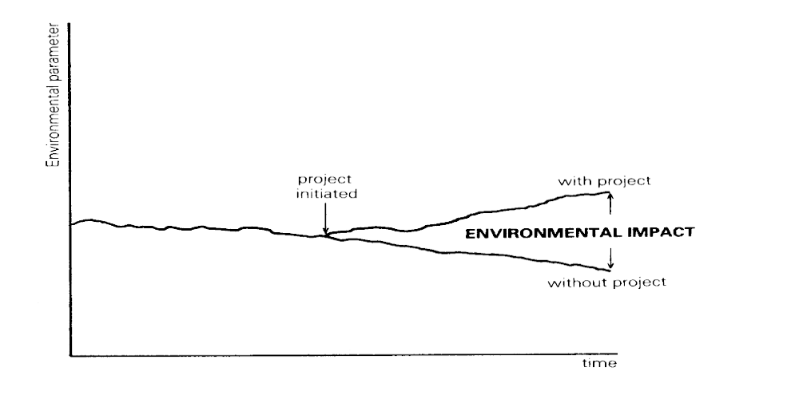
An environmental impact
(Wathern, 1988)

Slide 18

1.1 Environment
Global Environmental Issues
How many global environment issues do you know?
Climate Change and Global Warming
Biodiversity
Acid Rain
Marine Pollution
Ozone Layer Depletion
GE Food
Population Explosion
…

Slide 19
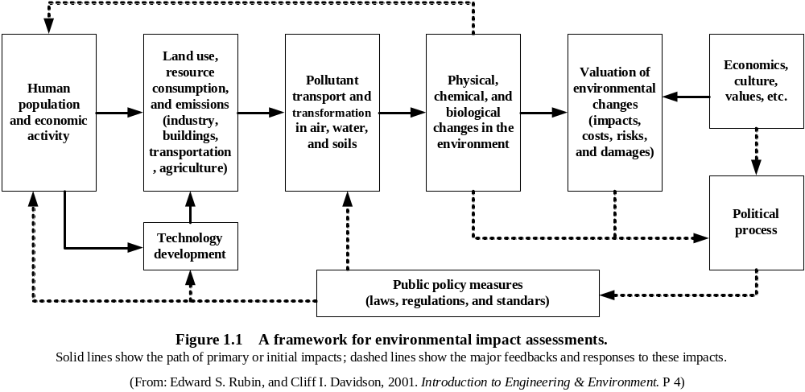
1.1 Environment
How Human Activity Influences The Environment

Slide 20


Why does environment matter?
Historical Background
Population Growth
Natural Resource Pressures
Urbanization
Industrialization

Slide 21

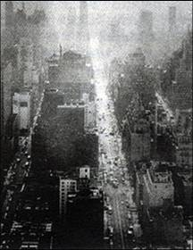
London smog incidents ：
1952年12月5-8日，Winter , fog and without wind.
Using coal to make warm, so dust and moisture were full of air.
People felt difficult to breathe and the eyes pain.
4000 people were died in only four days and 8000 people died during the following two months.
This was the largest incident by coal in the world in 20 century.

Slide 22
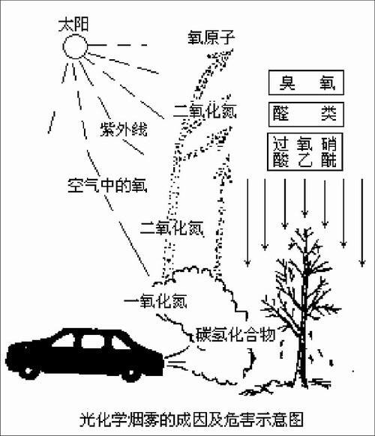
Los Angeles photochemical smog ：
From 1940s, there were yellow smog emerged at Los Angeles because of many cars.
The smog hurt the eye, throat and lungs.
It made many plants die and 400 people died in 1955.
This was the first air pollution incident induced by the off-gas from car.

Slide 23

Japanese Minamata disease incident ：
From 1949, one of the chemical fertilizer (for nitrogen) company used mercury as catalyzer. And the waste water were discharged without treatment.
In 1954,there was an unknown illness to cats and people. Most of them became crazy and cried until died.
After ten years, scientists found that it was mercury which caused the disease. Mercury was changed to methylated mercury (CH₃HCl) after eaten by fishes. And CH₃HCl hurt the brain and the balance system. There were more than 100,000 people who ate the polluted fishes in Japan.

Slide 24
1.2 Environment Impact Assessment
Genesis
In 1950s, to enhance the environmental protection management, environmental protection laws has been established in many countries .
The attitude to environmental protection:
Remedy / Fix / Repair →→→ Forecast / Prevent
International Symposium on Environmental Quality Assessment, 1964, Canada ----- “EIA” been introduced

Slide 25
Origins and history of EIA
1960s witnessed the emergence of environmentalism (e.g. publication of Silent Spring by Rachel Carson in 1962)
First formal system of EIA established in the US following the National Environmental Policy Act (NEPA) of 1969

Slide 26
National Environmental Policy Act (NEPA), 1969, U.S
“include in every recommendation or report on proposals for legislation and other major Federal actions significantly affecting the quality of the human environment, a detailed statement by the responsible official on --
(i) the environmental impact of the proposed action,
(ii) any adverse environmental effects which cannot be avoided should the proposal be implemented,
(iii) alternatives to the proposed action,
(iv) the relationship between local short-term uses of man's environment and the maintenance and enhancement of long-term productivity, and
(v) any irreversible and irretrievable commitments of resources which would be involved in the proposed action should it be implemented”
( Sec.102(C) )

Slide 27
Origins and history of EIA
NEPA sought to ensure that environmental concerns were considered in the decision-making of Federal Government agencies
Section 102(2)(c) required agencies to prepare a detailed statement on the environmental impact of “proposals for legislation and other major Federal actions significantly affecting the quality of the human environment”

Slide 28
Origins and history of EIA
The statement – referred to as an Environmental Impact Statement (EIS) - should include details on
  any adverse environmental effects which cannot be avoided should the proposal be implemented
  alternatives to the proposed action

Slide 29
Origins and history of EIA
Since 1969 a host of other countries have adopted EIA legislation
In 1977 the European Commission began drafting a directive on EIA and finally published a proposal in 1980
Directive 85/337/EEC on the assessment of the effects of certain public and private projects on the environment – the ‘EIA Directive’ was adopted in July 1985

Slide 30
1.2 Environment Impact Assessment
The Definition of EIA
A process through which environmental impacts (biophysical, social and economic) potentially resulting from a proposed project, are identified and assessed (early in the project planning phase).
EIA is a formal study process used to predict the environmental consequences of any proposed actions.
EIA ensures that the potential problems are foreseen and addressed at an early stage in action planning and design.
EIA is intended to indentify the environmental, social and economic impacts of a proposed development prior to decision making.

Slide 31
1.2 Environment Impact Assessment
The Objectives of EIA
To help decision-makers make well-informed decisions related to proposed projects/activities.
Predict environmental impact of actions;
Find ways and means to reduce adverse impacts;
Shape the actions to suit local environment;
Present the predictions and options to the decision-makers;

Slide 32
What is EIA?
EIA is a process of
gathering environmental information
describing a development
predicting and describing the environmental effects of the development
defining ways of avoiding, reducing or compensating for these effects
consulting the general public and specific bodies
taking all of this information into account
ensuring that the measures committed to or conditioned are implemented

Slide 33
A process which attempts to identify and predict the impacts of proposals, policies, programs, projects and operational procedures on the biophysical environment and on human health and well-being
It also interprets and communicates information about those impacts and investigates and proposes means for their management
A planning and decision-making tool to protect the natural environment and, thereby, protect human societies

Slide 34
Why do EIA ?
Promotes better planning and leads to more responsible decision making; ensures that renewable and non-renewable resources are used wisely
Evaluates the rationale behind proposed projects and activities; are there alternatives to a proposed project or activity?
Assists in pursuing sustainable development by evaluating alternatives means of undertaking proposed projects and activities

Slide 35
Why do EIA ?
Assessment outputs facilitate informed decision making; anticipated environmental impacts can be weighed against economic benefits and other social gains in deciding whether to approve or reject proposals
Helps to identify and understand environmental impacts early in the project cycle; predicted impacts can be mitigated before they occur
Provides opportunity for input from interested parties; increases likelihood of public acceptance

Slide 36
Why is EIA Needed ?
The natural environment is the foundation of the world economy and our social well-being
Past development practices have severely degraded the natural environment and wasted scarce resources
Increasing development pressures (e.g., industrialization, urbanization, and resource use) will inevitably accelerate environmental degradation unless sustainable environmental management practices are adopted

Slide 37
Benefits of EIA?
Can identify impacts in advance of actions
Can identify measures to mitigate predicted impacts
Preventative approach (proactive) – is more cost effective than finding a cure after the fact

Slide 38
The Benefits of EIA:
Reduced cost and time of project implementation
Cost-saving modifications in project design
Increased project acceptance
Avoiding impacts and violations of laws and regulations
Improved project performance
Avoiding waste treatment/clean up expenses

Slide 39
The Benefits of EIA:
The benefits to local communities from taking part in environmental impact assessments include:
A healthier local environment (forests, water sources, agricultural potential, recreational potential, aesthetic values, and clean living in urban areas)
Improved human health
Maintenance of biodiversity
Decreased resource use
Fewer conflicts over natural resource use
Increased community skills, knowledge and pride

Slide 40
What is the purpose of EIA ?
To “…encourage productive and enjoyable harmony between man and his environment; to promote efforts which will prevent or eliminate damage to the environment and biosphere and stimulate the health and welfare of man; to enrich the understanding of the ecological systems and natural resources important to the Nation....”
(National Environmental Policy Act of 1969, (NEPA) Section 2, as enacted by the Congress of the United States of America)

Slide 41
What is the purpose of EIA ?
“To implement a strategy of sustainable development, prevent adverse impact on the environment after the implementation of plans and construction projects, and promote coordinated development of the economy, society, and environment.”
(Environmental Impact Assessment Law, 1600/20002.10.28, adopted at the 30th Meeting of the Standing Committee of the 9th National Peoples Congress, Peoples Republic of China)

Slide 42
What is the purpose of EIA ?
To allow government officials, business leaders, and all concerned citizens to understand the likely environmental consequences of proposed actions, and to cooperate in making wise decisions that restore and maintain the quality of our shared environment for future generations.
R. B. Smythe

Slide 43
What is the purpose of EIA ?
“To LOOK before you LEAP!”
EIA is now a required process in more than 100 nations.
The International Association for Impact Assessment (IAIA) is a global network with 2,700 members from more than 80 countries.

Slide 44
WHAT CHANGES CAN EIA BRING?
Before introduction of EIA:
Government planning and decision-making:
“D-A-D” ---- “Decide, Announce, Defend”
Role of citizens:
“Critics” “Objectors” “Protestors”
Environmental conditions:
Steadily deteriorating

Slide 45
WHAT CHANGES CAN EIA BRING?
After Implementing EIA:
Government planning and decision-making:
“D-D-D” ---- “Discuss, Decide, Deliver”
Role of citizens:
“Stakeholders” “Contributors” “Participants”
Environmental conditions:
Deterioration slows; some areas improving
Source: Hui, Y.M. (Simon), Environmental Protection Dept., HKSAR

Slide 46
KEY ELEMENTS OF EIA
1. EIA must be undertaken EARLY in the development of proposed projects, plans, and programs, and must be completed BEFORE a decision to proceed is made.
2. EIA must be an OBJECTIVE, IMPARTIAL analytical process, not a way of promoting or “selling” a proposal to decision-makers—it must use accepted scientific principles and methods.

Slide 47
KEY ELEMENTS OF EIA
3. EIA must analyze all Reasonably Foreseeable environmental impacts or effects of a proposed action— effects may be short-term, long-term, direct, or indirect.
4. The process of EIA must be OPEN – to government officials at all levels, to potential stakeholders (those with direct interests in the proposed action), and to the PUBLIC.

Slide 48
KEY ELEMENTS OF EIA
5. There must be an early, public Scoping stage in EIA to consider Alternatives and to help focus subsequent analysis on the MORE SIGNIFICANT potential impacts – rather than studying all possible environmental effects—the GOAL is to reach a decision.
6. Government officials responsible for implementing EIA must Encourage (not just tolerate) PUBLIC PARTICIPATION in the process from the scoping stage forward.

Slide 49
KEY ELEMENTS OF EIA
7. In all EIA processes, effective Mitigation Measures must be identified and included—to avoid, minimize, or reduce the adverse effects of all potentially significant impacts.
8. EIA reports must include an Environmental Management (EMS) or Action Plan to Monitor the implementation phase of the project, plan, or program and provide for CORRECTIVE actions—such action plans must have assured FUNDING and be legally enforceable.

Slide 50
The EIA Directive
The EIA Directive requires projects likely to have significant effects on the environment by virtue of their nature, size or location to undergo an environmental assessment before the competent authority in question grants consent

Slide 51
The EIA Directive
The EIA Directive was amended in 1997 (Directive 97/11/EC). Following signature of the ‘Aarhus Convention’ on 25 June 1998, Directive 2003/35/EC was adopted which amends amongst others the EIA Directive and brings it into line with the public participation requirements of the Aarhus Convention

Slide 52
The EIA Directive
See the European Commission’s web pages on environmental assessment at:
http://europa.eu.int/comm/environment/eia/home.htm

Slide 53
The EIA Directive
The EIA Directive defines a project as
  the execution of construction works or of other installations or schemes,
  other interventions in the natural surroundings and landscape including those involving the extraction of mineral resources

Slide 54
The EIA Directive
The EIA should identify, describe and assess the direct and indirect effects of a project on the following factors:
  human beings, fauna and flora
  soil, water, air, climate and the landscape
  material assets and cultural heritage
  the interaction between the above factors
EIA should therefore have a strong social dimension

Slide 55
EIA Core Values
Sustainability: The EIA process will provide necessary environmental safeguards
Integrity: The EIA process will conform with established standards; underlying science is credible and decisions are justified
Utility: The EIA process will provide balanced, accurate information for decision making

Slide 56
EIA Guiding Principles
Participation: Appropriate and timely access by all interested parties
Transparency: All decisions should be open and accessible
Certainty: Process and timing agreed in advance and followed by all
Accountability: Decision makers and project proponents are responsible for their actions

Slide 57
EIA Guiding Principles
Credibility: Assessments are professional and objective
Cost-effectiveness: Environmental protection is achieved at the least cost
Flexibility: Process is adaptive and responsive
Practicality: Information and outputs are usable in decision making and planning

Slide 58
EIA Operational Principles
EIA should be applied to:
all development projects and activities likely to cause significant adverse impacts or potential cumulative effects
EIA should be undertaken:
throughout the project cycle, beginning as early as possible
in accordance with established procedures
to provide meaningful public consultation

Slide 59
EIA Operational Principles
EIA should provide the basis for:
environmentally-sound decision making in which terms and conditions are clearly specified and enforced
the development of projects and activities that meet environmental standards and management objectives
an appropriate follow-up process with requirements for monitoring, management, audits, and evaluation

Slide 60
EIA Operational Principles
EIA should address:
all related and relevant factors, including social and health risks and impacts
cumulative and long-term, large-scale effects
design, siting and technological alternatives
sustainability considerations including resource productivity, assimilative capacity and biological diversity

Slide 61
EIA Operational Principles
EIA should result in:
accurate information on the nature, likely magnitude and significance of potential effects, risks and consequences of proposals and alternatives
a relevant report for decision making; including qualifications on conclusions reached and prediction of confidence limits
ongoing problem solving and conflict resolution throughout the process

Slide 62
Integration of EIA into the
Decision-Making Process
Timing: EIA conducted early in the project cycle
Disclosure: EIA results disclosed to all interested parties
Weight: EIA results are considered by decision makers
Revisions: Plans revised to include feasible mitigation measures or a less damaging alternative

Slide 63
Integration of EIA into the Decision-Making Process
Mitigation: Agreed-upon mitigation measures are implemented and monitored for effectiveness
Monitoring: Post-project, follow-up monitoring of impacts conducted and results acted upon

Slide 64
Characteristics of Effective EIAs
Completeness:
  all significant impacts considered
  all relevant alternatives examined
Accuracy:
  appropriate forecasting procedures
  appropriate evaluation procedures
Clarity:
  all interested parties can comprehend issues

Slide 65
Sustainable Development
“Sustainable development is development that meets the needs of the present without compromising the ability of future generations to meet their own needs.”

Slide 66
Example Sustainability Criteria
Maintenance of habitat and ecosystems
Preservation of native plant and animal species
Preservation of cultural values
Reclamation and re-use of waste water
Wastewater disposal within assimilative capacity
Groundwater extraction within sustainable yield
Productive use of fertile soils
Prevention of erosion

Slide 67
Sustainability Criteria
Application of clean technology
Waste recycling or use
Material utilization allowing recycling or re-use
Energy efficiency/Use of renewable energy sources
Public acceptability/Involvement of the community
Full cost recovery for goods or services
Equitable cost-benefit distribution

Slide 68
Concluding Thoughts
Important points to remember are:
EIA is a structured process to anticipate, analyse and disclose environmental consequences associated with proposed projects or activities
EIA seeks to ensure that potential problems are foreseen and addressed such that project benefits can be achieved without causing serious environmental degradation
Done correctly, EIA can be a powerful environmental management tool

